Slide 1
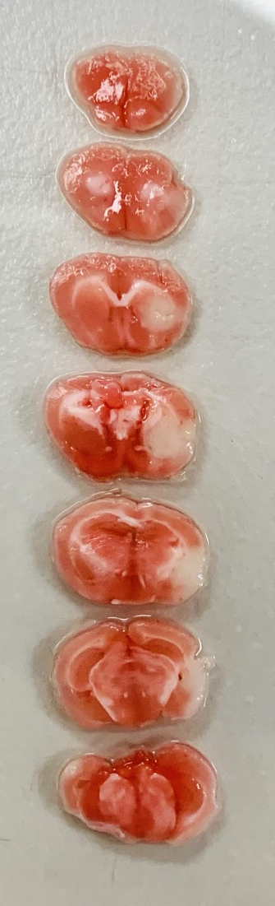
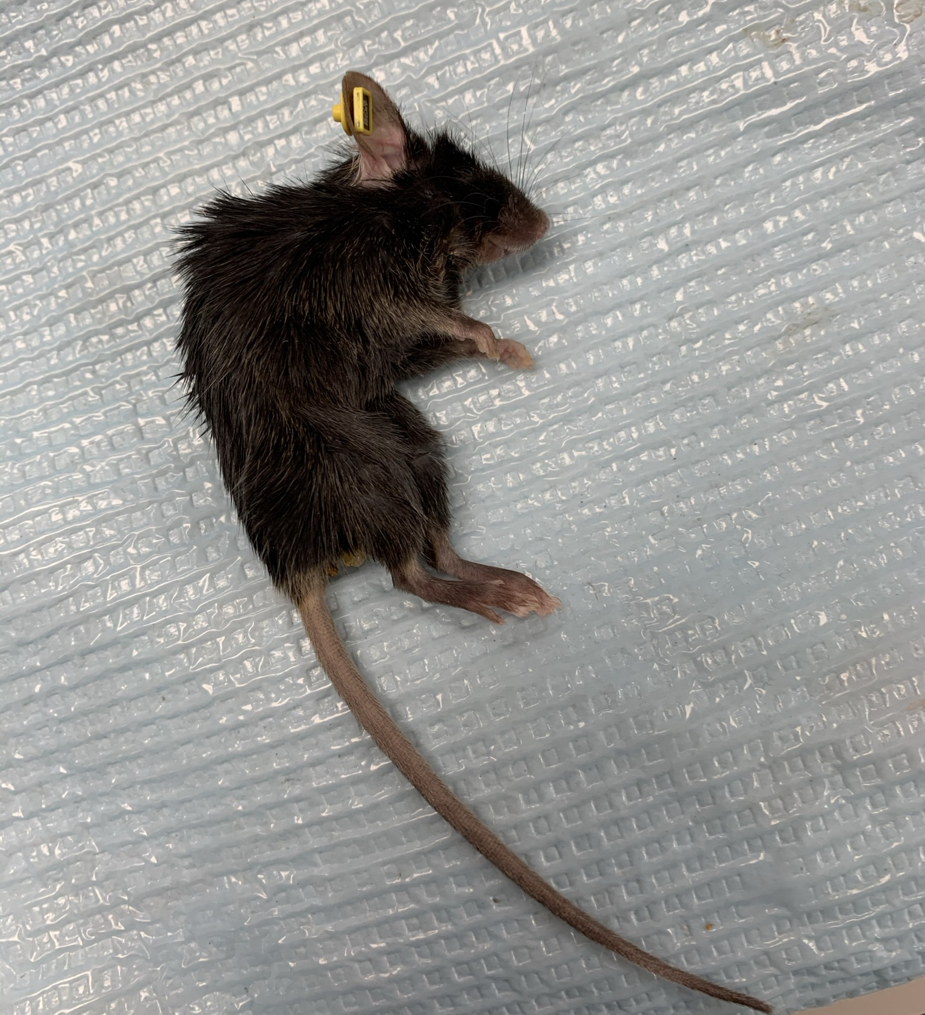
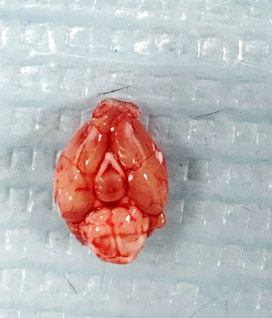
Mouse ID: AM5392
Date of surgery: 10/20/2020
Date on which found dead: 10/26/2020

